Slide 1
Chapter one
Introduction to software Engineering tools and practices

Slide 2
What is software?
Software is collection of computer programs, procedures, rules, and associated documentations and data.
Set of instruction or programs that direct the computer hardware or that help user to perform users task.
Software have variety of application or touch all aspect of human life. some of them are:
business domain
engineering domain(software used for drawing, drafting, modelling, etc)
Education domain
Etc

Slide 3
The Nature of Software
Software is intangible: Hard to understand development effort
Software is easy to reproduce: Cost is in its development
in other engineering products, manufacturing is the costly stage
Software is easy to modify
People make changes without fully understanding it.
Software does not ‘wear out’: It deteriorates by having its design changed:
Changes often tend to introduce new defects

Slide 4
What is Software Engineering?
The process of solving customers’ problems by the systematic development and evolution of large, high-quality software systems within cost, time and other constraints
Software Engineering can be defined as the construction of quality software with a limited budget and a given deadline in the context of constant change

Slide 5
Software Process
Process is a systematic series of actions directed to some end
Software Process [ software development life cycle (SDLC)] is structured set of activities required to develop a software system.
Requirement Specification - what the system should do and its development constraints
Development (design and implementation (Coding)) - production of the software system
Testing (Validation and verification) - checking that the software is error free and it is what the customer wants
Maintenance (Evolution) - changing the software in response to changing demands

Slide 6
Software Life Cycle
The time from the initial idea for a product until it is delivered is the development life cycle.
The time from the initial idea for a product until it is disposed of is called the product life cycle, or software life cycle, if we focus on software products.
Everything we do in software life seems to follow stages of software development.
Requirements engineering, designing, coding, testing, evolution.

Slide 7
Stages for software development
Requirement Analysis
Software Design
Implementation
Testing
Maintenance

Slide 8
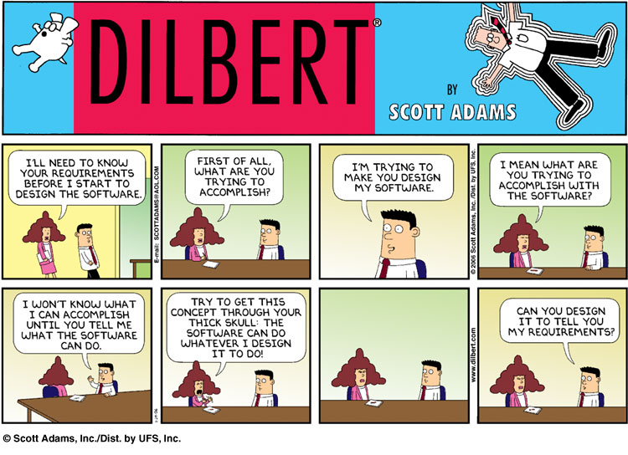
1. Requirements Analysis
Find out what the client want the software to do

Slide 9
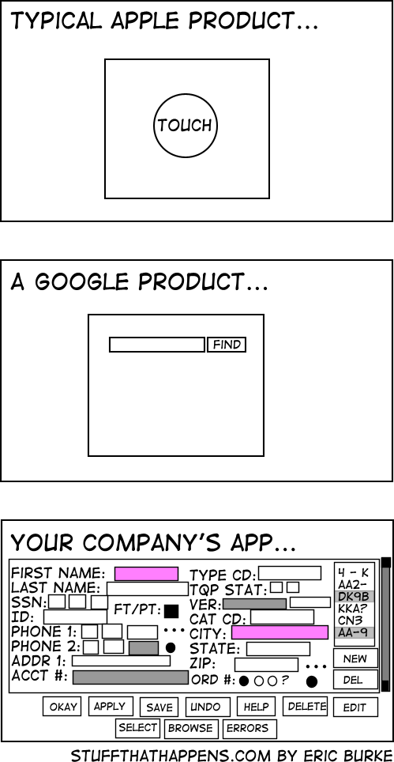
2. Design
Planning the software solution

Slide 10
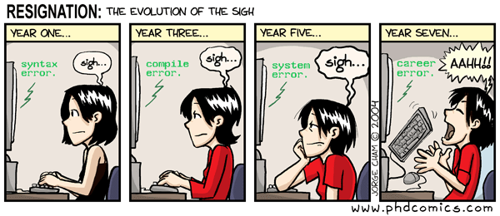
3. Implementation
Code!!!

Slide 11
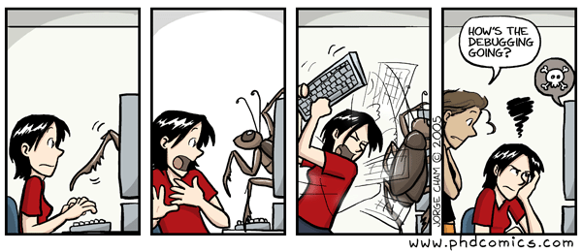
4. Testing
Executing the application trying to find software bugs

Slide 12
5. Maintenance
Any activity oriented to change an existing software product in response to customer demand.

Slide 13
Class Diagram
Class diagrams is a static diagram
Describe/ represents the static structure/ view of an application(system):
Objects,
Attributes, and methods
Associations.
Class diagram is not only used for visualizing, describing, and documenting different aspects of a system but also for constructing executable code of the software application.

Slide 14
Cont.…
Class diagrams can be directly mapped with object-oriented languages and thus widely used at the time of construction.
Class diagram shows a collection of classes, interfaces, associations, collaborations, and constraints.
The purpose of class diagram is to Model the static view of a system/Analysis and design of the static view of an application and Describe responsibilities of a system

Slide 15
Class Diagram basics/ Symbols and Notations
Class: Define the classes in an OO system. their fields and methods.
Classes are composed of three things: a name, attributes, and operations.
ClassName
Attributes
Operations
Notes:
The top partition contains the name of the class.
The middle part contains the class’s attributes.
The bottom partition shows the possible operations that are associated with the class

Slide 16
Cont..
Visibility: Define the access specification of class members(methods/attributes)
+ public
# protected
- private
~ package (default)

Slide 17
Cont...
However, the UML provides abbreviations for visibility: + (public), - (private), and # (protected).
A public member is visible anywhere in the program and may be called by any object within the system.(+)
A private member may be used only by the class that defines it.(-)
A protected member may be used only by
(a) the class that defines it or
(b) a subclass of that class.(#)

Slide 18
Attributes/Methods
attributes (fields, instance variables)
visibility name : type [count] = default_value
attribute example:
- balance : double = 0.00
Class operations / methods
visibility name (parameters) : return_type
parameter types listed as (name: type)
example:
+ distance(p1: int, p2: int): double
Rectangle
-width:int
-heght:int
/area:double
+rectangle(width:int,hegght:int):double
+distane(r.rectangle):double

Slide 19


Relationships between classes
Generalization: an inheritance relationship
Inheritance between classes
(dashed line, white arrow)
Interface implementation
(dashed line, white arrow)
Association: a usage relationship
Aggregation (clear white diamond)
Composition ( black diamond)
Multiplicity (how many are used)
* ===➔ 0, 1, or more
1 ===➔ 1 exactly
2..4 ===➔ between 2 and 4, inclusive
3..* ===➔ 3 or more (also written as “3..”)

Slide 20
Classes Relationships
A generalization: is used when two classes are similar, but have some differences. Read as “A kind of”
The association relationship is the most common relationship in a class diagram.
The association shows the relationship between instances of classes.

Slide 21
Cont..
all objects have their own lifecycle and there is no owner.
Let's take an example of Teacher and Student.
Multiple students can associate with single teacher and single student can associate with multiple teachers, but there is no ownership between the objects and both have their own lifecycle. Both can be created and deleted independently.
E.g. the class Order is associated with the class Customer.

Slide 22
Cont..
Uni-directional association, two classes are related, but only one class knows that the relationship exists.
Bi-directional association is a linkage between two classes. Associations are always assumed to be bi-directional; this means that both classes are aware of each other and their relationship, unless you qualify the association as some other type

Slide 23
Cont..
Aggregation: refers to the formation of a particular class as a result of one class being aggregated or built as a collection. Read as “part of”
E.g. the class “library” is made up of one or more books, among other materials.
In aggregation, the contained classes are not strongly dependent on the lifecycle of the container.
In the same example, books will remain so even when the library is dissolved.

Slide 24
Cont..
Composition: is very similar to the aggregation relationship with the only difference being its key purpose of stressing the dependence of the contained class to the life cycle of the container class.
That is, the contained class will be destroyed when the container class is destroyed.
composition: “is entirely made of”
Stronger version of aggregation
The parts live and die with the whole
E.g. a shoulder bag’s side pocket will also cease to exist once the shoulder bag is destroyed.

Slide 25
Bank
+address
+manage()
maintains
1..*
1
ATM
+location
+transaction()
1
1
manages
has
1..*
1..*
1
performs
Customer
ATMcard
+card_owner +card_number -pin
+access
1..*
owns
1..*
1..*
ATMTransaction
-transaction_id +date +type
+update()
1..*
1..*
1..*
owns
Account
get
access
1..*
Checking
Saving
Withdraw
Transfer

Slide 26
software UML tools
Since UML is a Unified Modeling Language, it is used to create meaningful, object-oriented models for a software application.
It clearly represents the working of any hardware/ software system.
There are numerous tools, both commercial and open-source, which are available for designing UML diagrams

Slide 27

StarUML
StarUML is an open-source software modeling tool, which is provided by MKLab.
It has different types of modeling diagrams.
Features:
It let you create Object, Use case, Deployment, Sequence, Collaboration, Activity, and Profile diagrams.
It offers multiplatform support (MacOS, Windows, and Linux).
Download link: http://staruml.io

Slide 28
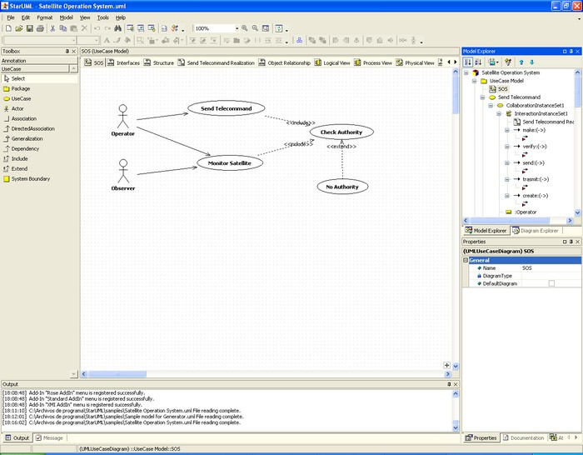
1. starUML screenshots

Slide 29
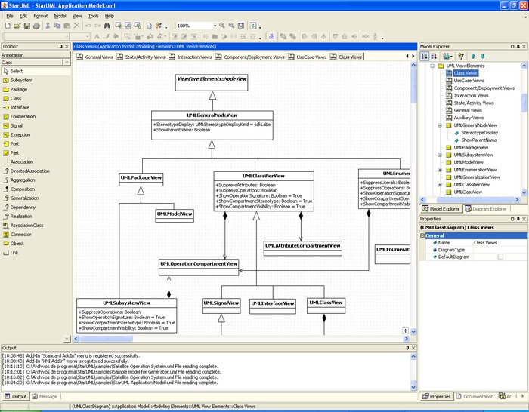
1. starUML screenshots

Slide 30
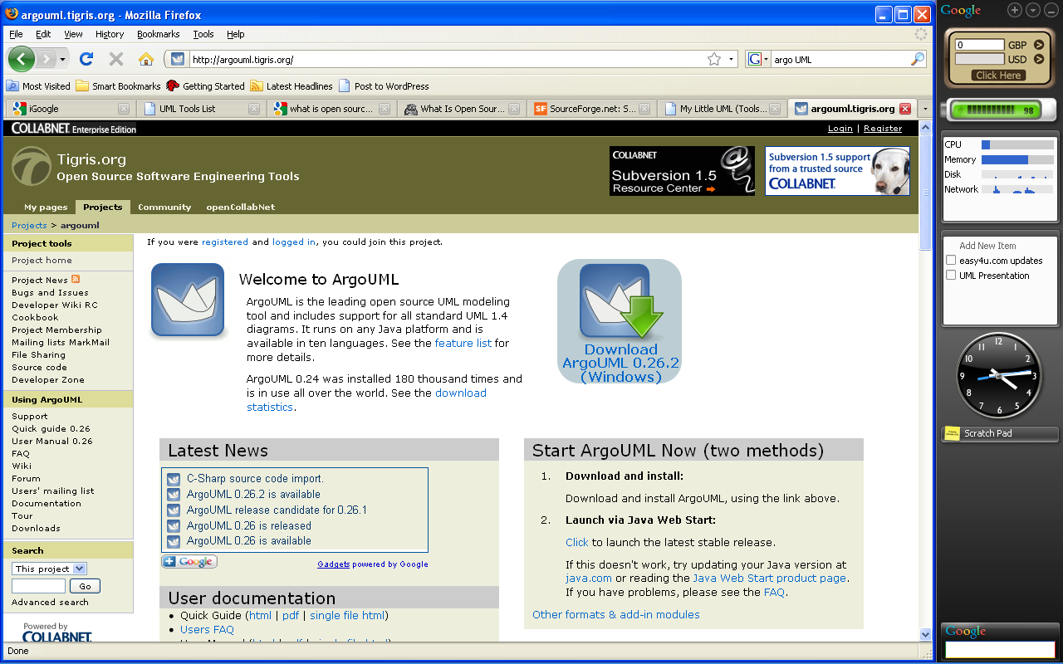
5. ArgoUML
ArgoUML is a powerful yet easy-to-use interactive Java based graphical software design environment that supports the design, development and documentation of object-oriented software applications.
A free research modelling tool;
fairly fully featured,the main goal is to have a Really Useful user interface, unlike almost all existing CASE tools;

Slide 31
Cont…
The users of ArgoUML are
software designers & architects
software developers
systems analysts and
other professionals involved in the analysis, design and development of software applications.

Slide 32
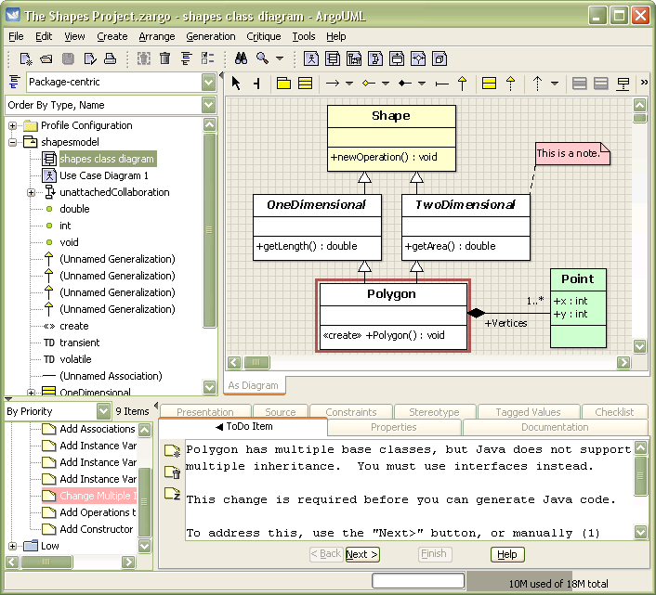

Slide 33
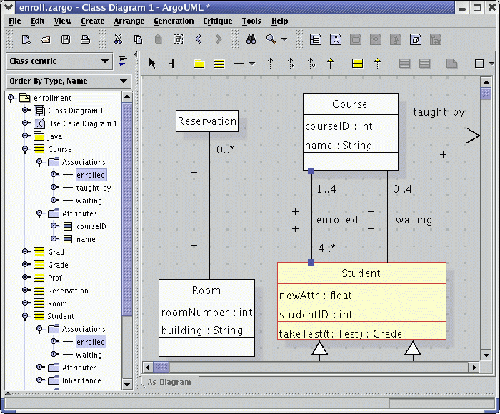
ArgoUML – class diagram

Slide 34
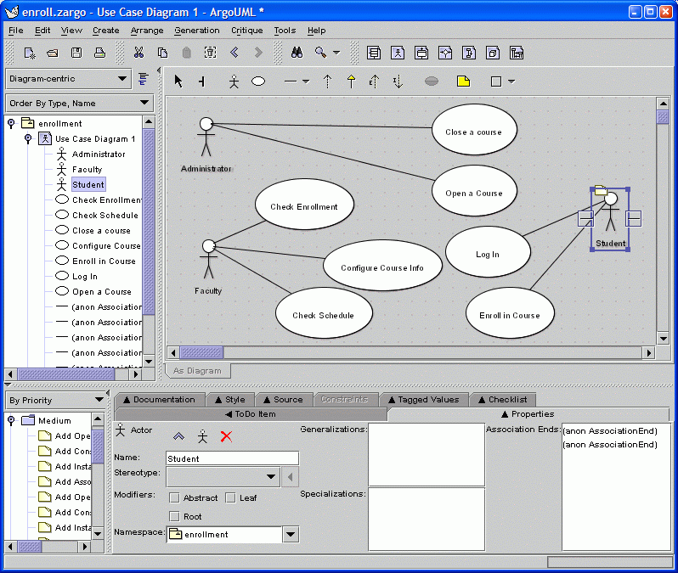
Argo UML – Use Case Diagram

Slide 35
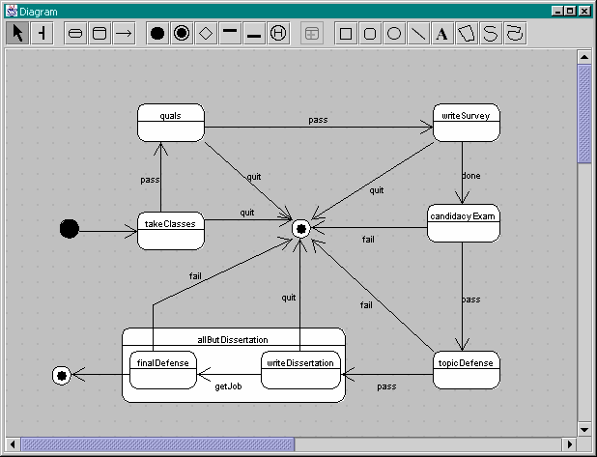
Argo UML – State Chart Diagram

Slide 36

Commercial Tools
Buy software’s by
money

Slide 37
Commercial Tools
IBM Rational Rose
SmartDraw
Enterprise Architect
Poseidon for UML
Borland Together
Sybase Power Designer

Slide 38
IBM Rational Rose
Rational Rose is often considered the definitive UML tool because the founders of the Rational company also include the creators of UML.
Early versions of Umbrello described it as an equivalent of Rational that it has a similar user interface layout.
perhaps the best known UML tool; free to universities (if you ask)

Slide 39
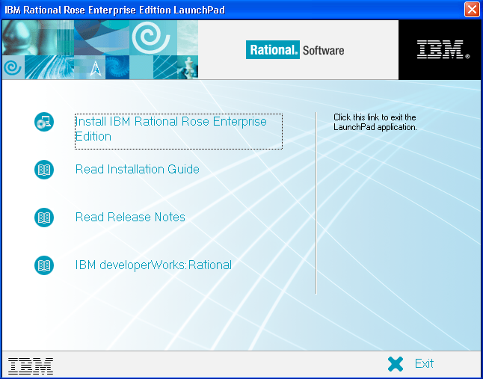

Slide 40
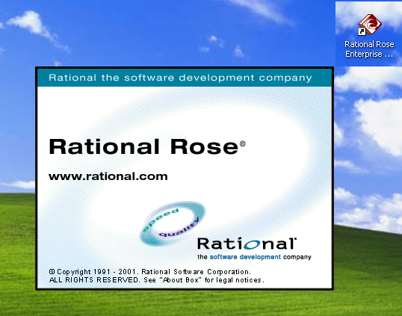

Slide 41
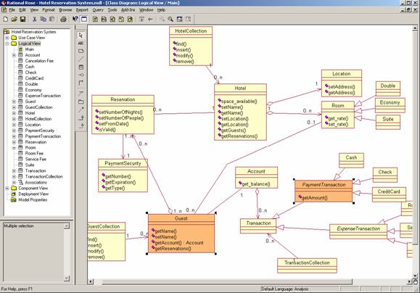
Hotel Reservation System in Rational Rose

Slide 42
Microsoft Visio
Instead of static pictures, create data-connected Visio diagrams that display data, are easy to refresh, and dramatically increase your productivity.
Use the wide variety of diagrams in Office Visio 2007 to understand, act on, and share information about organizational systems, resources, and processes throughout your enterprise.
Source: http://office.microsoft.com/en-us/visio/HA101656401033.aspx

Slide 43
